Slide 1
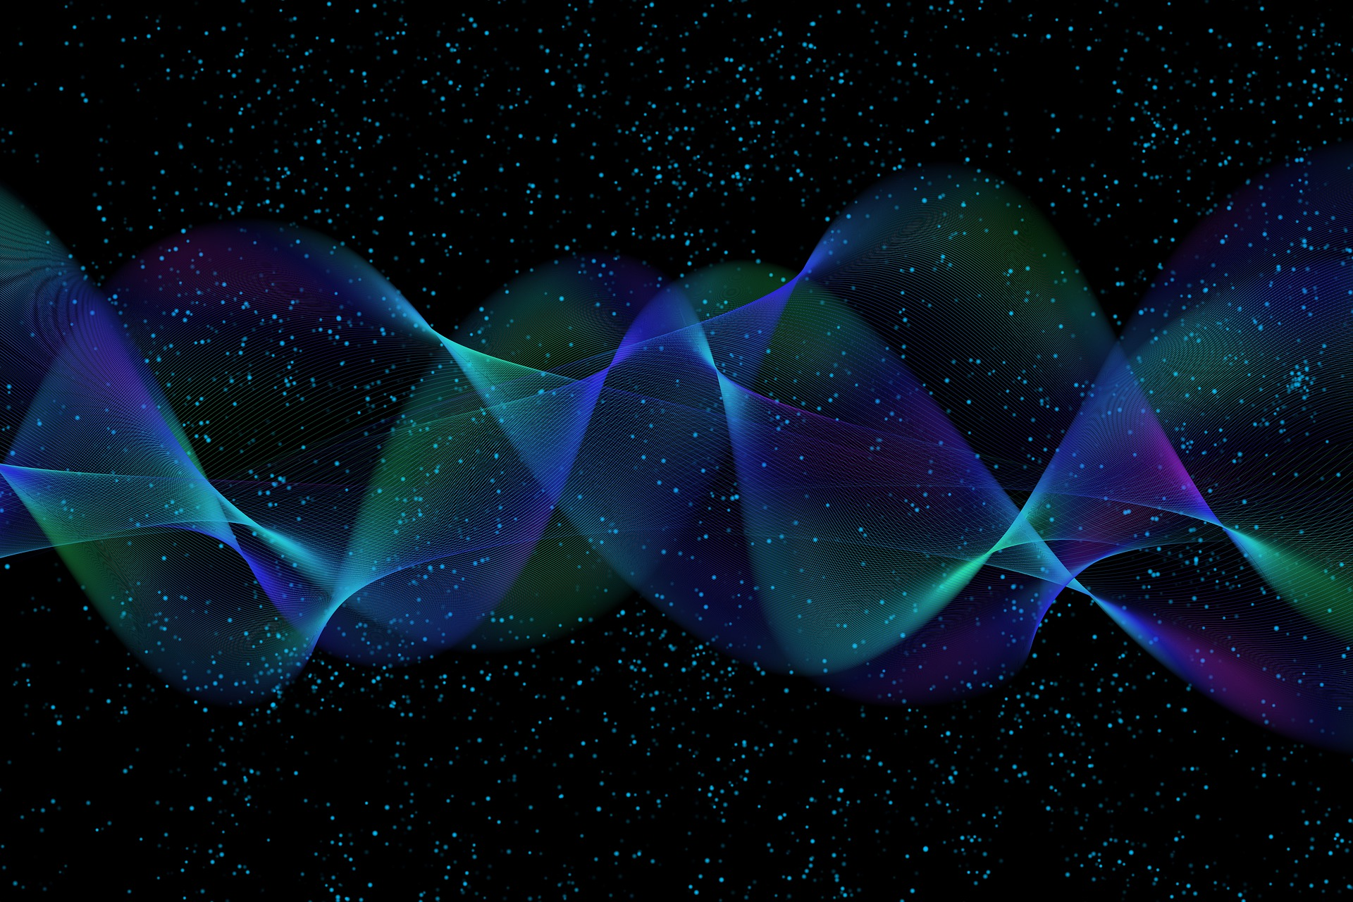
Quantum Computing
7. Quantum Cryptography
Quantum Computing Insitute
https://qcict.org
Prof. Aleksandar Radovanovic
alex@qcict.org

Slide 2
The Science of Information Protection
Cryptology
Cryptography
Cryptanalysis
Classical
Quantum
Symmetric
Asymmetric
Hash functions
Post-quantum
Quantum key distribution (QKD)
Quantum hash
Quantum digital signatures
QRNG
Notes:
The science of information protection is called cryptology, which includes both cryptography and cryptanalysis.
Cryptography develops methods for protecting information.
Cryptanalysis develops methods for breaking or analyzing cryptographic protections.
Modern cryptography can be broadly divided into:
Classical Cryptography
Symmetric-key cryptography (e.g., AES)
Asymmetric-key cryptography (e.g., RSA)
Cryptographic hash functions (e.g., SHA-256)
Post-Quantum Cryptography
Quantum-resistant cryptographic algorithms that run on classical computers
Quantum Cryptography
Quantum random number generation (QRNG)
Quantum key distribution (QKD)
Quantum digital signatures
Quantum hashing
Post-quantum cryptography is not quantum cryptography. Post-quantum cryptography uses classical computers and classical communication, but algorithms are designed to resist attacks by quantum computers. Quantum cryptography, by contrast, uses quantum states and quantum-mechanical principles as part of the cryptographic process.

Slide 3

Cryptography
Cryptography is the science that develops methods for keeping information secure
The word originates from the ancient Greek word κρυπτός (kryptós), meaning "hidden," and γράφειν (gráphein), meaning "to write," thus "hidden writing."
Classical &
postquantum cryptography
relies on mathematical principles
Quantum cryptography
uses the laws of quantum mechanics
Notes:
Cryptography is the science that develops methods for keeping information secure
The word cryptography comes from the Greek words kryptos (hidden) and graphein (to write), meaning “hidden writing.”
Classical cryptography relies on mathematical principles, while quantum cryptography uses the laws of quantum mechanics to provide security.

Slide 4

XOR One-time Pad
Encryption
plaintext
H
E
L
L
O
cipher
XOR
key
AA
05
4E
F2
35
A cipher is the algorithm that
defines how the key is applied
XOR
ciphertext
E2
40
02
BE
7A
Decryption
Notes:
As a brief introduction to cryptographic terminology, consider a simple XOR-based one-time pad, based on the Vernam cipher introduced by Gilbert Vernam in 1917.
The text or data to be encrypted is called plaintext or cleartext. In our example, it is the word HELLO.
Encryption is the process of transforming plaintext into ciphertext.
A cryptographic key is a sequence of values used together with the plaintext during encryption to produce the ciphertext. In this example, the key is a sequence of random bits with the same length as the message. For simplicity, the binary sequence is shown in hexadecimal form.
A cipher is the algorithm that defines how the key is applied. In this example, the cipher performs a simple XOR operation between the bits of the message and the corresponding bits of the key, producing the ciphertext.
The reverse process of recovering the original plaintext from the ciphertext is called decryption. Here, decryption is performed by applying the same XOR operation to the ciphertext and the key. The same key is therefore used for both encryption and decryption.
A one-time pad is theoretically unbreakable if the key is truly random, at least as long as the message, kept secret, and never reused.

Slide 5



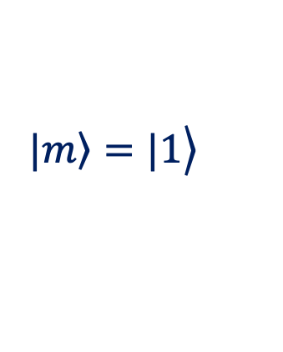

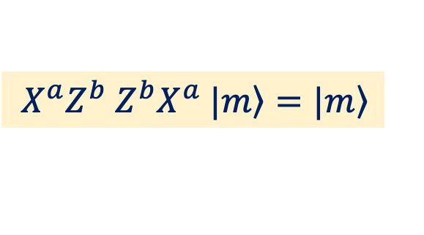
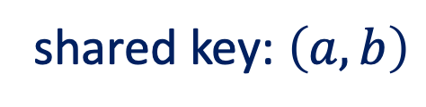



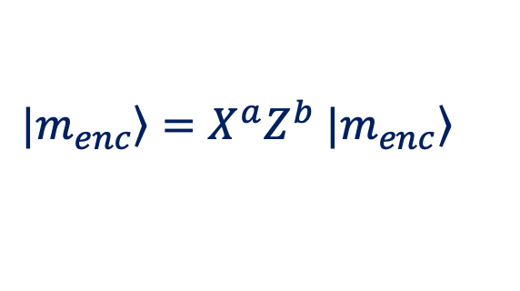



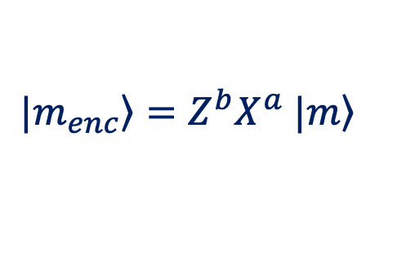
The Quantum One-Time Pad (QOTP) / Pauli Encryption
shared key: $\left(a,b\right)$
$$==1$$
$$==1$$
$$a=1$$
$$a=1$$
$$==1$$
$$==1$$
$$b=0$$
$$b=0$$
$$\left.\left.|m\right\rangle =|1\right\rangle$$
+
Z
Z
+
$$\left.\left.|m\right\rangle =|1\right\rangle$$
Encryption (Alice):
Decryption (Bob):
$\left.|m_{enc}\right\rangle =Z^{b}X^{a}$ $\left.|m\right\rangle$
$\left.|m_{enc}\right\rangle ={X^{a}Z}^{b}$ $\left.|m_{enc}\right\rangle$
${X^{a}Z}^{b}$ $Z^{b}X^{a}$ $\left.|m\right\rangle =\left.|m\right\rangle$
Notes:
The simplest form of the Quantum One-Time Pad (QOTP), also called Pauli encryption, encrypts each qubit using two classical secret bits.
Alice and Bob share a two-bit classical secret key (a,b), which is used to encrypt each qubit that Alice sends to Bob.
Alice applies the X and Z operations according to the key bits a and b, respectively. In the example shown, a=1 and b=0, so the X operation is applied, while the Z operation is not.
After receiving the encrypted qubit, Bob applies the same operations in reverse order, using the same key bits.
Considering the quantum circuit as a whole, the encryption and decryption operations cancel each other. If Alice applies $Z^{b}X^{a}$, Bob applies the operations in reverse order: ${X^{a}Z}^{b}$, giving ${X^{a}Z}^{b}$ $Z^{b}X^{a}=I$
To encrypt larger quantum states, the QOTP can be applied to multiple qubits in parallel. For example, encrypting an 8-qubit register requires 16 classical key bits, two for each qubit.
The Quantum One-Time Pad randomly transforms each qubit using one of four Pauli operations: I, X, Z, or XZ similar to how the classical one-time pad transforms classical bits using XOR with a random key.
The QOTP provides information-theoretic secrecy when the key is uniformly random, kept secret, used only once, and contains two classical bits for each encrypted qubit.

Slide 6

Hash Function
message
hash
HASH
In cryptography, trust is encrypted
in every bit.
4e64bdf98bd6db782d654d4a3b259f27b1284e9bfb8d8c4267fbe8e42d3aa685
SHA-256
A hash is a mapping of an input of arbitrary length to an output of fixed length.
Notes:
Cryptographic hash functions are mathematical functions that take an input of any length and produce an output of fixed length, called the hash value (or simply the hash). A cryptographic hash function is one-way, meaning that it is practically impossible to reconstruct the original input from its hash value.
Because of this property, hashes are not used to transmit data directly, but are commonly used to verify data integrity or as part of digital signatures. For example, a sender may send a message together with its hash. The receiver can compute the hash of the received message and compare it with the original hash. If they match, this provides evidence that the message has not been altered.
A known limitation of hash functions is the possibility of a collision, which occurs when two different inputs produce the same hash. For a modern 256-bit cryptographic hash function such as SHA3-256, there are
2²⁵⁶≈1.16×10⁷⁷ possible hash values. However, because of the birthday effect, finding a collision by brute force requires approximately 2¹²⁸≈3.4×10³⁸ attempts, which is still computationally infeasible.

Slide 7
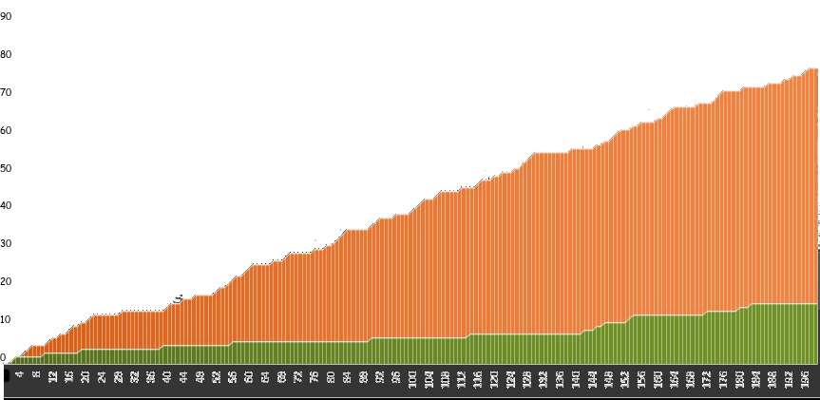
Quantum Attacks on Hash Functions
[%]
quantum ~ 75%
classical ~ 15%
https://www.linkedin.com/pulse/quantum-acceleration-fraud-real-lets-try-break-hash-function-parisel/
Notes:
The question is: can a quantum computer attack a hash function and compromise the security of digital signatures?
The simple experiment resulted in the chart shown in the figure, comparing how often classical and quantum searches successfully found an input corresponding to a given 4-bit hash value.
The green chart represents the success rate of the classical search, which is about 15%. The orange chart represents the quantum search. By applying Grover’s algorithm, the quantum computer was able to find a matching input in about 75% of the cases.
Although demonstrated using a very small 4-bit hash, the experiment illustrates how quantum algorithms can accelerate attacks on cryptographic hash functions, potentially reducing their effective security.

Slide 8
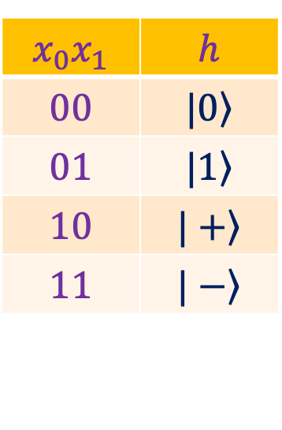
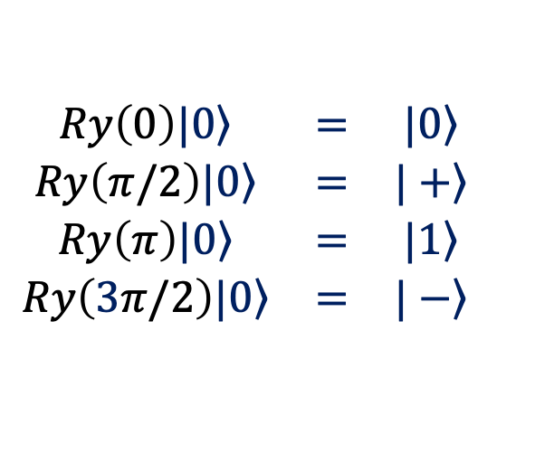
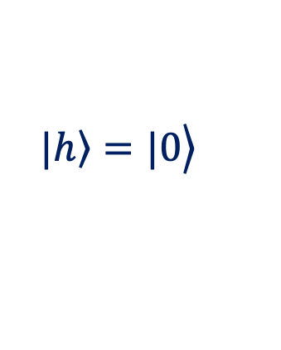
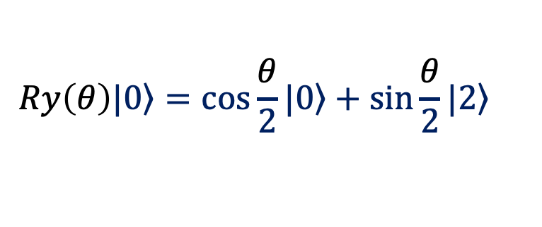

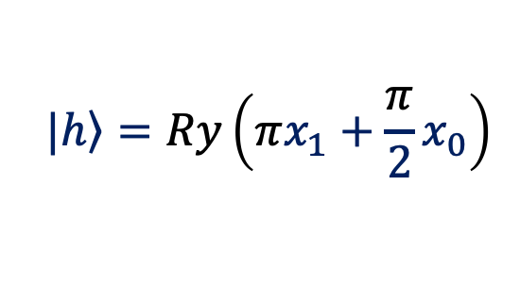

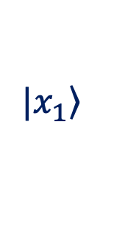

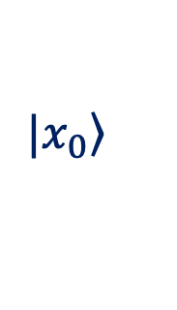

Quantum Hashing with Controlled Rotations
$$\left.|x_{0}\right\rangle$$
$$\left.|x_{0}\right\rangle$$
$$\left.|x_{1}\right\rangle$$
$$\left.|x_{1}\right\rangle$$
$$\left.\left.|h\right\rangle =|0\right\rangle$$
RY
RY
$$\left.|h\right\rangle =Ry\left(πx_{1}+\frac{π}{2}x_{0}\right)$$
$π$/2
$$π$$
$$x_{0}x_{1}$$ | $$h$$
$$00$$ | $$\left.|0\right\rangle$$
$$01$$ | $$\left.|1\right\rangle$$
$$10$$ | $$\left.|+\right\rangle$$
$$11$$ | $$\left.|−\right\rangle$$
$$\begin{matrix}Ry\left(0\right)\left.|0\right\rangle & = & \left.|0\right\rangle \\ Ry\left(π/2\right)\left.|0\right\rangle & = & \left.|+\right\rangle \\ Ry\left(π\right)\left.|0\right\rangle & = & \left.|1\right\rangle \\ Ry\left(3π/2\right)\left.|0\right\rangle & = & \left.|−\right\rangle \end{matrix}$$
$$Ry\left(θ\right)\left.|0\right\rangle =\cos{\frac{θ}{2}}\left.|0\right\rangle +\sin{\frac{θ}{2}}\left.|2\right\rangle$$
Notes:
This quantum circuit illustrates a simple quantum hash encoding for a two-bit input, based on controlled Ry rotations. The inputs are two data qubits in the states $\left.|x_{0}\right\rangle$ and $\left.|x_{1}\right\rangle$, together with a hash qubit initialized in |0⟩.
The input qubits control two rotations applied to the hash qubit: $Ry\left(π/2\right)$, controlled by $\left.|x_{0}\right\rangle$, and $Ry\left(π\right)$, controlled by $\left.|x_{1}\right\rangle$. Their combined effect rotates the hash qubit by an angle determined by the input bits.
At the output, the data qubits remain unchanged, while the hash is encoded in the state $\left.|h\right\rangle =Ry\left(πx_{1}+πx_{0}/2\right)$. Thus, the four possible classical inputs produce four quantum hash states, equivalent up to global phase to: |0⟩, |1⟩, |+⟩, |−⟩.
The hash is therefore encoded in the quantum state of a single qubit. Unlike classical information, an unknown quantum state cannot be perfectly copied, and non-orthogonal quantum states cannot generally be perfectly distinguished by a single measurement. These properties can be exploited in the design of quantum cryptographic protocols.
More complex quantum hash constructions can be obtained by using larger input spaces, multiple hash qubits, and more complex quantum transformations.

Slide 9
Quantum Key Distribution Protocols
Notes:
Encryption schemes such as the One-Time Pad require both parties to share the same secret key. The problem of securely establishing such a key can be solved using Quantum Key Distribution (QKD), which uses the principles of quantum mechanics to allow two parties to establish a shared secret key and detect the presence of an eavesdropper.

Slide 10








BB84 (Bennett and Brassard 1984) Quantum Key Distribution (QKD)
1.
Alice sends key bits as polarized photons in random bases.
0
$$\left|−\right\rangle$$
$$\left|+\right\rangle$$
1
$$\left|0\right\rangle$$
$$\left|1\right\rangle$$
0
1
1010
2.
Bob receives the qubits and measures them in a random basis.
Alice
Alice and Bob exchange their basis information and discard key bits with mismatched bases.
3.
Bob
Key
0 1
Notes:
The first and most famous QKD protocol is BB84, proposed by Charles Bennett and Gilles Brassard in 1984. The name BB84 comes from the authors' initials and the year in which the protocol was introduced. Today, BB84 and related QKD protocols are beginning to see practical and commercial deployment.
In the first step, Alice sends a random sequence of bits encoded as polarized photons, randomly choosing between two bases. A bit 0 can be represented by the state ∣0⟩ or ∣+⟩, while a bit 1 can be represented by ∣1⟩ or ∣−⟩.
Upon receiving each photon, Bob randomly chooses either the standard basis or the diagonal basis and performs a measurement.
Since Bob does not know which basis Alice used, he chooses the wrong basis about 50% of the time. Measurements made using the wrong basis produce random results and are later discarded.
Alice and Bob then publicly exchange information about the bases they used, without revealing their bit values. They discard all results for which their bases do not match. Since their bases match approximately 50% of the time, about half of the original bits remain, forming the sifted key.
What happens if Eve intercepts the quantum communication?
Eve cannot simply make a perfect copy of an unknown quantum state because of the no-cloning theorem. In a simple intercept–resend attack, she must measure the photon and then send a replacement to Bob. Because Eve does not know Alice's basis, she sometimes measures in the wrong basis, disturbing the transmitted state and introducing detectable errors.
Alice and Bob therefore publicly compare a small subset of their sifted bits to estimate the quantum bit error rate (QBER). In an ideal BB84 system without Eve, the QBER would be zero, although practical systems have some errors due to noise and imperfections. A full intercept–resend attack produces a QBER of approximately 25%. If the observed QBER is too high for secure key generation, Alice and Bob abort the protocol and discard the key.
For ideal BB84, a QBER of about 11% is often cited as the maximum level for secure key generation under standard assumptions. Higher error rates cause the protocol to abort.

Slide 11






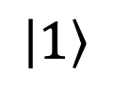




binary key
1
0
1
0
0
1
1
0
0
1
0
1
$$\left|1\right\rangle$$
$$\left|0\right\rangle$$
$$\left|−\right\rangle$$
$$\left|+\right\rangle$$
$$\left|0\right\rangle$$
$$\left|1\right\rangle$$
$$\left|−\right\rangle$$
$$\left|+\right\rangle$$
qubits
Bob’s base
1
0
0
0
0
1
1
1
raw key
sifting
1
$$−$$
$$−$$
0
0
$$−$$
1
$$−$$
sifted key
Notes:
Suppose Alice and Bob want to establish a secret key that will later be used for AES encryption.
Alice encodes randomly generated bits into photons by preparing their polarization states, randomly choosing the basis for each bit.
Upon receiving the photons, Bob measures them using his own polarization basis, which he also chooses randomly. The resulting measurement data form Bob's raw key.
Alice and Bob then exchange information about the bases they used. This information is transmitted over an authenticated public classical channel, typically encoded in binary form, for example, 0 for the standard basis and 1 for the diagonal basis. They do not reveal the actual bit values.
Using this information, they perform sifting: they keep only the bits for which their bases matched and discard the rest. The remaining bits form their sifted keys.
The next phase is post-processing, also called key distillation. Alice and Bob first estimate the error rate by publicly comparing a small portion of their sifted bits. If the error rate is too high, they abort the protocol and discard the key.
If the error rate is acceptable, they perform error correction to ensure that their remaining bits are identical. Finally, they apply privacy amplification, typically using a suitable hash function, to produce a shorter secret key. This reduces any partial information that Eve may have obtained to a negligible level.

Slide 12
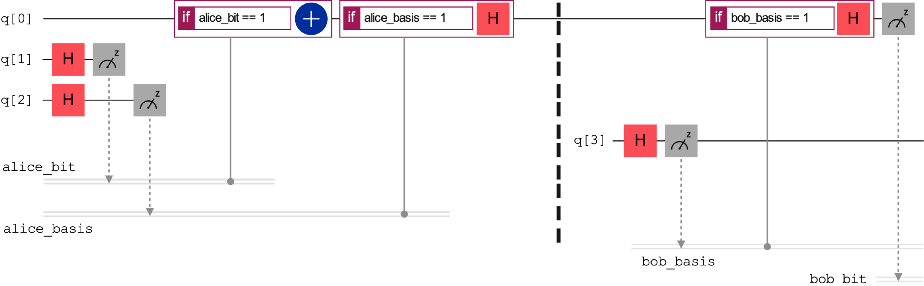
BB84 Protocol: 1-Bit Example
Notes:
The circuit shows an example of the 1-bit BB84 protocol.
Alice prepares q[0] in the state ∣0⟩.
Alice generates two random bits: alice_bit is the bit she wants to transmit as part of the key, while alice_basis determines the basis used for encoding.
If alice_bit is 1, Alice applies the X gate, changing q[0] to the state ∣1.
If alice_basis is 1, she applies the Hgate, encoding q[0] in the diagonal basis as ∣+⟩ or ∣−⟩.
On Bob’s side,
Bob generates a random bit bob_basis to select his measurement basis.
If bob_basis is 1, Bob applies the H gate before measurement, effectively measuring in the diagonal basis.
Bob then measures the qubit.
In the next step, Alice and Bob exchange their basis bits. If their bases match, they keep the transmitted bit; otherwise, they discard it.

Slide 13
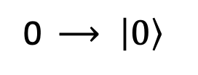



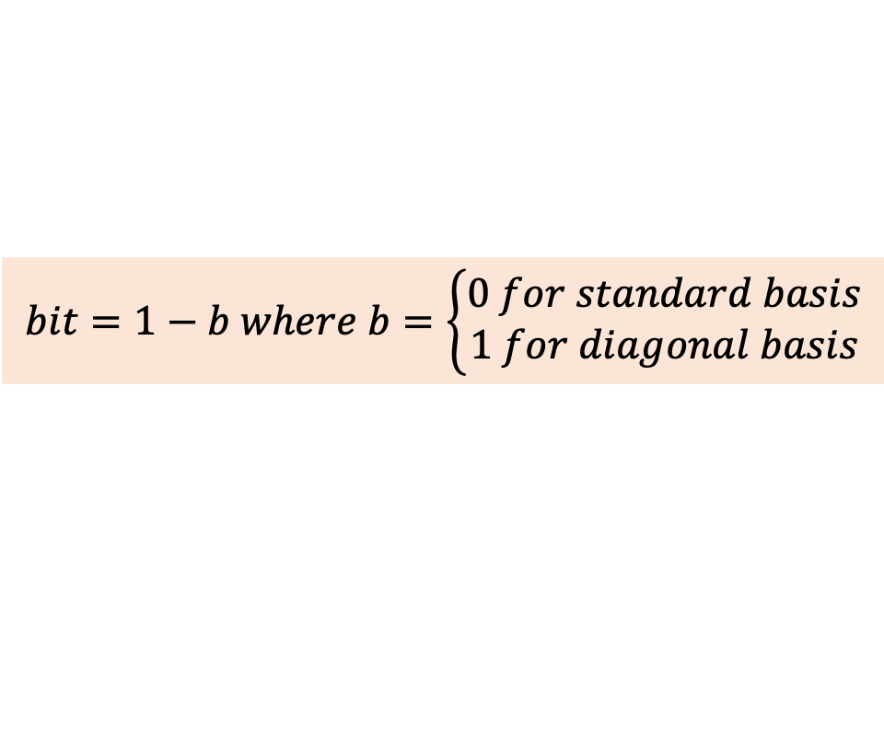
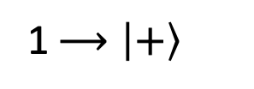

B92 Protocol / Bennett (1992)
1 $⟶\left|+\right\rangle$
0 $⟶ \left|0\right\rangle$
Standard measurement
Diagonal measurement
$$\left|+\right\rangle ⟶0 or 1$$
$$\left|+\right\rangle ⟶0$$
if 1 is measured,
then a bit 1 was sent
if 1 is measured,
then a bit 0 was sent
$$\left|0\right\rangle ⟶0$$
$\left|0\right\rangle$ $⟶0 or 1$
$$bit=1−b where b=\left\{\begin{aligned}0 for standard basis \\ 1 for diagonal basis\end{aligned}\right.$$
Notes:
In 1992, Charles Bennett introduced a simpler version of BB84, known as the B92 protocol. Instead of using four possible quantum states, as in BB84, B92 uses only two non-orthogonal states. For example, Alice can encode bit 0 as ∣0⟩ and bit 1 as ∣+⟩, and then send the qubits to Bob.
Bob measures each qubit by randomly choosing either the standard basis {∣0⟩,∣1⟩} or the diagonal basis {∣+⟩,∣−⟩}.
Suppose Bob measures in the standard basis:
If Alice sends a bit 0 as |0⟩, Bob always obtains |0⟩.
If Alice sends a bit 1 as |+⟩, Bob obtains |0⟩ or |1⟩, each with probability 1/2 .
Therefore, a result of ∣0⟩ is inconclusive, because either state could have produced it. However, a result of ∣1⟩ proves that Alice could not have sent ∣0⟩, so Bob concludes that Alice sent bit 1.
Suppose Bob measures in the diagonal basis:
If Alice sends a bit 0 as |0⟩, Bob obtains ∣+⟩ or ∣−⟩, each with probability 1/2.
If Alice sends a bit 1 as |+⟩, Bob always obtains ∣+⟩.
Therefore, a result of ∣+⟩ is inconclusive. However, a result of ∣−⟩ proves that Alice could not have sent ∣+⟩, so Bob concludes that Alice sent bit 0.
In summary, all inconclusive outcomes are discarded.
Standard basis: ∣1⟩ means Alice sent bit 1.
Diagonal basis: ∣−⟩ means Alice sent bit 0.
This rule can be expressed with a simple formula for the key bit:
$$bit=1−b, where b=\left\{\begin{aligned}0 for standard basis \\ 1 for diagonal basis\end{aligned}\right.$$

Slide 14
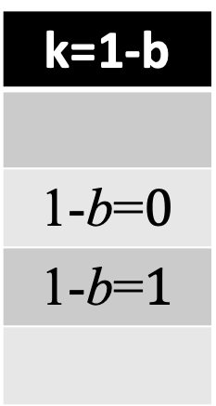
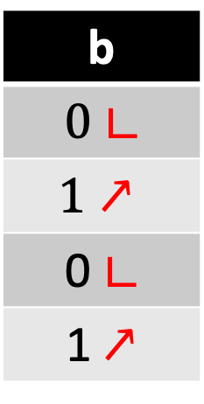
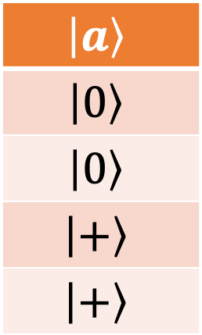
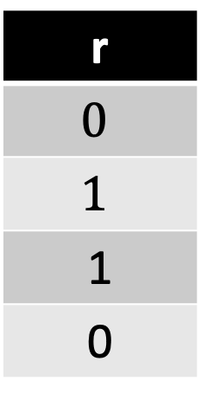
B92 Protocol Example
a
$$0$$
0
1
1
$$\left|a\right\rangle$$
$$\left|0\right\rangle$$
$$\left|0\right\rangle$$
$$\left|+\right\rangle$$
$$\left|+\right\rangle$$
b
$0$ $∟$
$$1↗$$
0 $∟$
1 $↗$
r
$$0$$
$$1$$
1
0
k=1-b
1-b=$0$
1-b=$1$
Q
Notes:
Let’s take a simple example to see how the B92 protocol works.
Alice first generates a random 4-bit sequence, denoted by ‘a’.
She encodes each bit using one of two possible states: a 0 is sent as ∣0⟩, while a 1 is sent as ∣+⟩. These qubits are then transmitted to Bob through the quantum channel.
For each qubit he receives, Bob chooses a random bit b:
If b = 0, he measures in the standard basis.
If b = 1, he measures in the diagonal basis.
The measurement outcomes form a sequence of bits r. Outcomes with r = 0 are inconclusive and are discarded. Bob tells Alice, over a public classical channel, which positions produced conclusive results, (r=1) without revealing the corresponding bit values.
For each position where r=1, Bob reconstructs the corresponding key bit using k=1−b. Alice keeps the corresponding bits from her original sequence. In the absence of errors or eavesdropping, Alice's retained bits and Bob's reconstructed bits are identical and form their sifted key.
To detect eavesdropping, Alice and Bob publicly compare a random subset of their sifted key bits. An unexpectedly high error rate may indicate eavesdropping or excessive channel noise. If the error rate is too high, they abort the protocol and discard the key.

Slide 15
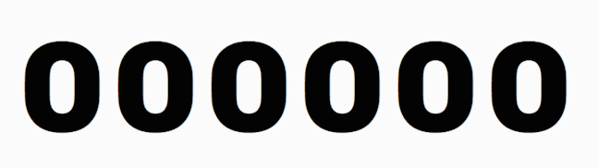
E91 protocol /Artur Ekert (1991)
SpooQy-1
Notes:
Another important class of quantum key distribution protocols is based on entangled photons. The most famous example is the E91 protocol, proposed by Artur Ekert in 1991.
In this scenario, an independent source produces pairs of entangled photons. Alice receives one photon from each pair, while Bob receives the other. If they both measure their photons in the standard basis, their results are correlated because of entanglement. Repeating this process allows Alice and Bob to generate the same sequence of random bits, which can be used to establish a shared key. The security of entanglement-based QKD comes from the fact that any attempt to intercept or measure the entangled photons disturbs their quantum correlations and can therefore be detected.
An example of this technology is SpooQy-1, a small nanosatellite launched in 2019. The name SpooQy-1 is a playful reference to Einstein’s famous description of entanglement as “spooky action at a distance.” It was only about 30 centimeters in size, but it was able to generate pairs of entangled photons in space. Its purpose was to demonstrate that a compact source of entangled photons could successfully function aboard a satellite. This was an important step toward future satellite-based quantum communication.

Slide 16
Entanglement-Based QKD via Satellite
Yin, J., Li, YH., Liao, SK. et al. Entanglement-based secure quantum cryptography over 1,120 kilometres. Nature 582, 501–505 (2020).
Notes:
In China, researchers have made impressive progress using entangled photons. In 2020, the Micius satellite distributed pairs of entangled photons from an altitude of about 500 km to two ground stations separated by approximately 1,120 km. Using these entangled photons, researchers demonstrated quantum key distribution with a secret-key rate of about 0.12 bits per second. Importantly, this was achieved without the need for a trusted relay between the two stations.
Reference:
Yin, J., Li, YH., Liao, SK. et al. Entanglement-based secure quantum cryptography over 1,120 kilometres. Nature 582, 501–505 (2020).

Slide 17

SA and China create world's longest quantum satellite link
Stellenbosch University
https://www.sun.ac.za/english/Lists/news/DispForm.aspx?ID=11179
Notes:
More recently, in 2024, scientists from South Africa and China achieved another major milestone in quantum communication. Using the Jinan-1 microsatellite and a portable ground station at Stellenbosch University, they established a quantum-secured link between Stellenbosch and Beijing, separated by about 12,900 km.
The system generated quantum keys in real time, which were then used to securely encrypt and transmit images between South Africa and China. This set a new record for intercontinental quantum-secured communication and established the first quantum satellite communication link in the Southern Hemisphere.
Quantum scientists connect SA, China to shatter satcom record
https://www.universityworldnews.com/post.php?story=20250323135915656
Li, Y., Cai, WQ., Ren, JG. et al. Microsatellite-based real-time quantum key distribution. Nature 640, 47–54 (2025). https://doi.org/10.1038/s41586-025-08739-z
https://www.nature.com/articles/s41586-025-08739-z.epdf

Slide 18

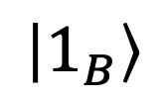
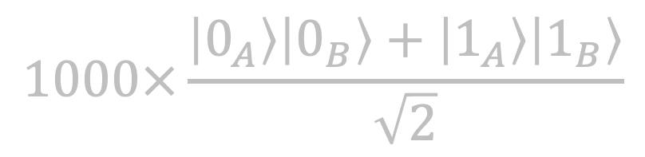
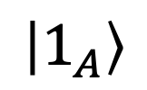
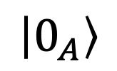
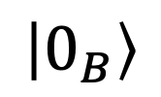
E91: Detecting an Untrusted Source
statistical method of error detection
$$\left|0_{A}\right\rangle$$
$$1000×\frac{\left|0_{A}\right\rangle \left|0_{B}\right\rangle +\left|1_{A}\right\rangle \left|1_{B}\right\rangle }{\sqrt{2}}$$
$$\left|0_{B}\right\rangle$$
$$\left|1_{A}\right\rangle$$
$$\left|1_{B}\right\rangle$$
Notes:
One of the main advantages of the E91 protocol is that it can provide security even when Alice and Bob do not fully trust the source of the entangled photons.
Imagine that Alice and Bob rent a communication link from Eve and ask her to provide them with 1,000 pairs of entangled qubits.
Eve, however, tries to cheat. Instead of sending genuinely entangled pairs, she sends non-entangled qubits whose states she already knows, effectively trying to plant her own key.
To check the security of the channel, Alice and Bob use a subset of the received qubits to test their quantum correlations. By measuring them using different measurement settings, they can perform a Bell inequality test. Genuinely entangled qubits can produce correlations that violate a Bell inequality, something that ordinary classically correlated qubits cannot reproduces.

Slide 19
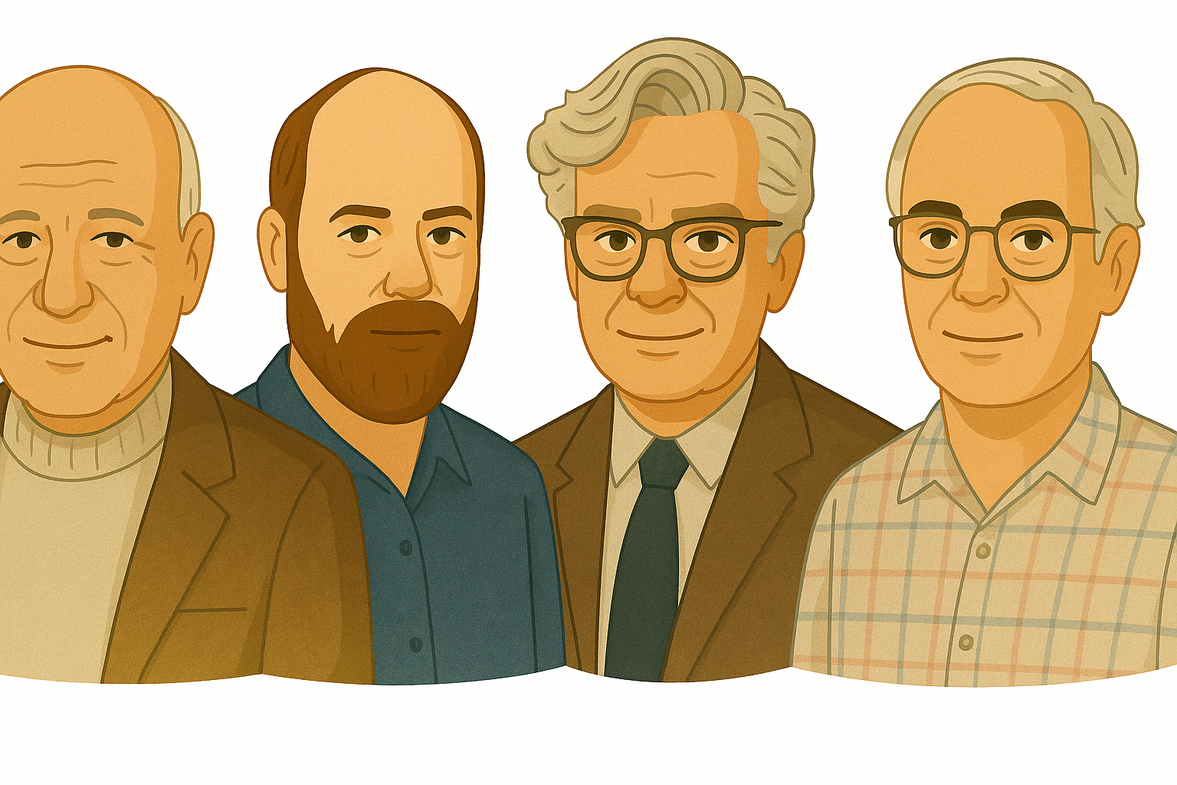


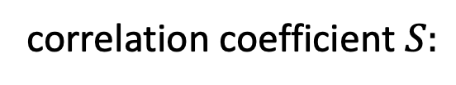



Bell’s Inequality and the CHSH Test
J. Clauser, M. Horne, A. Shimony, R. Holt
quantum-mechanical correlation
John Bell (1928 – 1990)
correlation coefficient $S:$
$$S$$
$$0$$
$$1$$
$$2$$
$$2\sqrt{2}$$
classical correlation
Notes:
When two qubits are entangled, their measurement results can show correlations that cannot be explained by classical physics. To distinguish these quantum correlations from ordinary classical correlations, physicist John Bell developed a test known as Bell’s inequality.
Today, one of the most commonly used versions is the CHSH inequality, named after Clauser, Horne, Shimony, and Holt. It defines a parameter S, calculated from correlations measured using different measurement settings.
According to the CHSH inequality, classical correlations must satisfy $|S|≤2$. If an experiment produces $\left|S\right|>2$ the CHSH inequality is violated, providing evidence of non-classical quantum correlations. Under ideal conditions, maximally entangled qubits can reach the maximum quantum value $\left|S\right|=2\sqrt{2}≈2.38.$

Slide 20
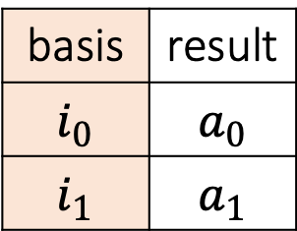

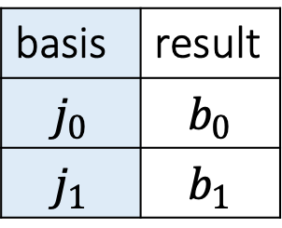


CHSH Test: Verifying Entanglement
basis | result
$$i_{0}$$ | $$a_{0}$$
$$i_{1}$$ | $$a_{1}$$
basis | result
$$j_{0}$$ | $$b_{0}$$
$$j_{1}$$ | $$b_{1}$$
$$A_{0}={\left(−1\right)}^{a_{0}},A_{1}={\left(−1\right)}^{a_{1}}$$
$$B_{0}={\left(−1\right)}^{b_{0}},B_{1}={\left(−1\right)}^{b_{1}}$$
$$\left\langle A_{i}B_{j}\right\rangle =p_{00}−p_{01}−p_{10}+p_{11}$$
$$|S|=|\left\langle A_{0}B_{0}\right\rangle +\left\langle A_{0}B_{1}\right\rangle +\left\langle A_{1}B_{0}\right\rangle −\left\langle A_{1}B_{1}\right\rangle |≤2$$
Notes:
Suppose, for example, that Alice and Bob receive a sequence of entangled photon pairs from Eve via satellite, which they want to use to generate a secret key. However, they are both suspicious that Eve might replace the entangled photons with her own photons and, in this way, effectively impose her own key. To verify that the received photons are indeed entangled, they calculate the correlation measure S, which should be greater than 2 for quantum correlations.
For each received photon pair, Alice randomly chooses one of two measurement bases, i₀ or i₁, while Bob chooses one of the bases j₀ or j₁. Their measurement results are denoted by a₀ and a₁, and b₀ and b₁, respectively. Of course, for each individual photon pair, Alice and Bob each choose only one basis and obtain only one measurement result.
Since the measurement outcomes are 0 or 1, for the purpose of calculating the correlations they are transformed into the values +1 and −1. A measurement result of 0 is mapped to +1, while a result of 1 is mapped to −1.
$$A_{0}={\left(−1\right)}^{a_{0}},A_{1}={\left(−1\right)}^{a_{1}}, B_{0}={\left(−1\right)}^{b_{0}},B_{1}={\left(−1\right)}^{b_{1}}$$
Alice and Bob repeat this procedure many times and then group their results according to the four possible combinations of measurement bases. For each combination, they calculate the average product of their measurement outcomes.
In simple terms, they count how often they obtain the outcomes 00, 01, 10, and 11. Equal outcomes, 00 and 11, contribute +1, while different outcomes, 01 and 10, contribute −1. The correlation is therefore calculated by adding the relative frequencies of equal outcomes, p₀₀ + p₁₁, and subtracting those of different outcomes, p₀₁ + p₁₀.
For example, if they perform 100 measurements and obtain the outcome 00 forty times, the relative frequency of this outcome is 0.4. The relative frequencies of the other outcomes are calculated in the same way.
In this way, Alice and Bob obtain four correlation coefficients, one for each combination of measurement bases. They then combine these coefficients according to the CHSH expression shown on the slide to obtain the final value of S.
If the absolute value of S is less than or equal to 2, the observed correlations can be explained classically. If it is greater than 2, quantum correlations have been detected. Under ideal conditions, for maximally entangled qubits, the value can reach 2√2, or approximately 2.83.
The closer the measured value is to 2.83, the closer the observed correlations are to those expected from an ideal maximally entangled system.

Slide 21


CHSH Game :Classical Strategy
$$x$$
$$y$$
$$a$$
$$b$$
?
$$x∙y=a⊕b$$
$$x,a$$ | $$y,b$$ | $$x∙y$$ | $$a⨁b$$ | Alice & Bob win if
0 | 0 | 0 | 0 | $$a=b$$
0 | 1 | 0 | 1
1 | 0 | 0 | 1
1 | 1 | 1 | 0 | $$a≠b$$
classical strategy
75% wins
Notes:
As an illustration of classical correlations, consider a simple example known as the CHSH game. Alice and Bob play together against Charlie. Once the game begins, Alice and Bob cannot communicate, although they can agree on a strategy beforehand.
Charlie begins by randomly generating two bits, x and y, for example by flipping two coins.
He sends x to Alice and y to Bob.
Without communicating with each other, Alice returns a bit a, while Bob returns a bit b.
Alice and Bob win if x · y = a ⊕ b, where ⊕ represents addition modulo 2.
Looking at the four possible combinations of x and y, the product x · y is 0 in three cases and 1 in only one.
Alice and Bob can therefore agree beforehand to always return the same bit, for example a = b = 0. Since a ⊕ b is then always 0, they win in three out of four cases, giving a success probability of 75%. Importantly, 75% is the maximum success probability that Alice and Bob can achieve using any classical strategy without communicating during the game.

Slide 22






CHSH Game: Quantum Strategy
$$\frac{\left|0_{A}\right\rangle \left|0_{B}\right\rangle +\left|1_{A}\right\rangle \left|1_{B}\right\rangle }{\sqrt{2}}$$
$$x=0$$
$$x=1$$
$$x=0$$
$$\left|1\right\rangle$$
$$\left|+\right\rangle$$
$$\left|v_{1}\right\rangle$$
$$\left|1\right\rangle$$
$$y=1$$
$$\left|0\right\rangle$$
$$π/4$$
$$π/8$$
$$\left|0\right\rangle$$
$$\left|v_{0}\right\rangle$$
$$\left|−\right\rangle$$
$$\left|u_{1}\right\rangle$$
$$y=1$$
$$x=1$$
$$\left|v_{1}\right\rangle$$
$$y=0$$
$$\left|v_{1}\right\rangle$$
$$\left|1\right\rangle$$
$$\left|u_{0}\right\rangle$$
$$y=1$$
$$\left|+\right\rangle$$
$$π/8$$
$$P={\left|\cos{\frac{π}{8}}\right|}^{2}=0.85355≈85\%$$
$$π/8$$
$${−π}/8$$
$$\left|v_{0}\right\rangle$$
$$\left|v_{0}\right\rangle$$
Notes:
But Alice and Bob can do even better by using a quantum strategy. Before the game begins, they share a pair of maximally entangled qubits in the Bell state $\left|B_{00}\right\rangle$ and agree on their measurement settings. During the game they cannot communicate. They simply measure their qubits according to the bits received from Charlie and return their measurement results.
If Alice receives x=0, she measures in the computational basis {|0⟩, |1⟩}, assigning bit 0 to |0⟩ and bit 1 to |1⟩.
If Alice receives x=1, she measures in the diagonal basis {|+⟩, |−⟩}, again assigning results 0 and 1.
If Bob receives y=0, he measures in a basis rotated by +π/8 relative to the computational basis, assigning the results |u₀⟩ and |u₁⟩ to bits 0 and 1.
If Bob receives y=1, he measures in a basis rotated by −π/8, assigning |v₀⟩ and |v₁⟩ to bits 0 and 1.
Consider first the case x=0 and y=1. Alice measures in the computational basis and, suppose, obtains |1⟩. Because the qubits are entangled, Bob's qubit is projected onto the corresponding state |1⟩. Bob measures this state in his rotated basis. According to Born's rule, the probability that he obtains the same bit as Alice is cos²(π/8), or approximately 85%. The same probability is obtained if Alice measures |0⟩.
Now consider the most interesting case, x=y=1. In this case x·y=1, so Alice and Bob must return different bits to win. Suppose Alice measures |+⟩, corresponding to bit 0. Bob's qubit is projected onto the corresponding state |+⟩. Because of Bob's choice of measurement basis, he obtains the opposite bit with the same probability of approximately 85%.
Remarkably, the same winning probability applies to all four possible combinations of x and y. The overall probability of winning with this quantum strategy is therefore approximately 85%, compared with the maximum classical probability of 75%.
This advantage comes from quantum entanglement, which allows Alice and Bob to produce correlations that cannot be reproduced by any classical strategy without communication. The same principle is used in entanglement-based quantum cryptography to test whether distributed qubits exhibit genuine quantum correlations.
Reference:
http://quantumgazette.blogspot.com/2016/07/chsh-game-and-quantum-entanglement.html

Slide 23
Other Applications of Quantum Cryptography

Slide 24

Quantum banknote: Q-note
qubit in a secret state |Q⟩
Q-note
$$\text{|}\text{Q}\text{⟩}$$
Stephen Wiesner (1942-2021)
26481
serial number s
ordered pair: (s, |Q⟩)
Notes:
Around 1968, Stephen Wiesner proposed using quantum states for communication and introduced another remarkable idea for its time: quantum money. Here, we will present Wiesner’s idea of quantum money in the context of modern quantum computing.
Just as a conventional banknote has a serial number and security features designed to make counterfeiting difficult, a quantum banknote, which we will call a Q-note, can be represented by an ordered pair: a classical serial number s and a qubit prepared in a secret quantum state ∣Q⟩.

Slide 25



How Quantum Money Works
USER
HACKER
Q-note request
& issuance
①
BANK
forgery attempt
$$\left|Q\right\rangle$$
(s, |Q⟩)
issuer/verifier
③
②
s | |Q⟩
1234 | |0⟩
5678 | |+⟩
… | …
Q-note usage
Q-note
verification
$$\left|Q\right\rangle$$
MERCHANT
Notes:
In a quantum money system, a user obtains a quantum banknote from a bank. In our simplified example, the note consists of a serial number $s$ and a secret quantum state $\left|Q\right\rangle :$ $(s,\left|Q\right\rangle )$. The bank stores the serial number together with the information needed to verify the corresponding quantum state.
When the user wants to spend the note, they give it to a merchant, who sends it to the bank for verification. The bank uses the serial number to find the corresponding record and then performs the appropriate quantum measurement. If the measurement confirms the expected state, the note is accepted as valid and the payment can proceed. An attacker cannot simply copy the quantum part of the banknote. According to the no-cloning theorem, an unknown quantum state cannot be perfectly duplicated.
An attacker could steal or copy the classical serial number, but that alone is not enough to create a valid banknote. They would also have to reproduce the correct secret quantum state.

Slide 26

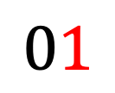
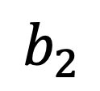


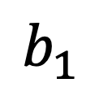
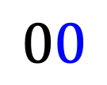
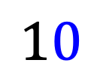
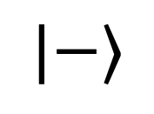




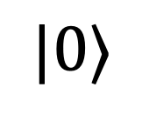


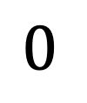
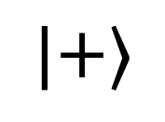



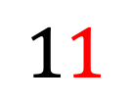
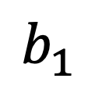
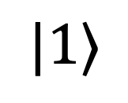

Encoding a Quantum Banknote
qubit state encoded by bits b₁b₂
z-axis is encoded as b₂ = 0
$0$
$$|0⟩$$
qubit ($b_{1}$)
$$\left|0\right\rangle$$
$$b_{1}$$
$$00$$
$$0$$
(state)
$$\left|−\right\rangle$$
$$|1⟩$$
$1$
axis ($b_{2}$)
$$11$$
$$b_{2}$$
(basis)
$0$
$$|+⟩$$
$$\left|+\right\rangle$$
$$10$$
$$1$$
$$01$$
$$b_{1}$$
(state)
$$y$$
$$x$$
$$\left|1\right\rangle$$
$$1$$
$$|−⟩$$
x-axis is encoded as b₂ = 1
Notes:
In Wiesner's quantum money, each qubit is prepared in one of two possible bases: the computational basis {∣0⟩,∣1⟩} or the diagonal basisl {∣+⟩,∣−⟩}).
Instead of storing a copy of the quantum state, the bank stores classical information describing how the qubit was prepared. In our simplified Q-note, this information is represented by two secret bits $b_{1}$​ and $b_{2}$​, stored together with the serial number.
The bit $b_{2}$​ selects the basis, while$b_{1}$​selects the state within that basis.:
If $b_{2}=0$, the Z-basis is used:
$b_{1}=0$ corresponds to Q-note=$\left|0\right\rangle$
$b_{1}=1$ corresponds to Q-note=$\left|1\right\rangle$
If $b_{2}=1$, the X-basis is used:
$b_{1}=0$ corresponds to Q-note=$\left|+\right\rangle$
$b_{1}=1$ corresponds to Q-note=$\left|−\right\rangle$
So, using only two classical secret bits, the bank can specify one of four possible quantum states for each qubit in the Q-note.

Slide 27
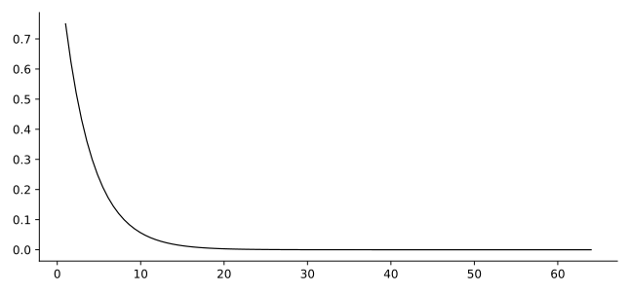
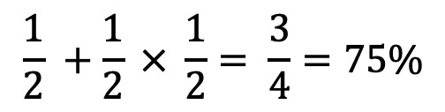






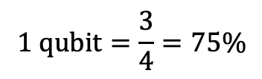


Resistance to quantum attacks
$$1 qubit=\frac{3}{4}=75\%$$
$$\left|0\right\rangle$$
$$\left|−\right\rangle$$
$$\left|+\right\rangle$$
$$x$$
$$\left|1\right\rangle$$
$$y$$
probability
$${\left(3/4\right)}^{n}$$
$${64 qubits/10}^{−8}$$
qubits
guessing probability $=$ 50% correct basis $+$ 50% incorrect basis $× \frac{1}{2}$ $=$
$$\frac{1}{2} +\frac{1}{2} × \frac{1}{2}= \frac{3}{4}=75\%$$
Notes:
Knowing the serial number of a quantum banknote, a hacker could try to create a forged qubit by guessing its secret state. The bank, however, stores two pieces of information for each qubit: the expected bit value and the basis in which it should be measured.
Without knowing the basis, the hacker has a 50% chance of choosing correctly, in which case the qubit passes the test with certainty. If the wrong basis is chosen, there is still a 50% chance of passing by accident. The overall probability of successfully forging one qubit is therefore P=0.5×1+0.5×0.5=0.75
So a single-qubit Q-note would have a 75% probability of successful forgery.
In the example shown, the secret state is ∣+⟩, which the bank verifies by measuring in the diagonal basis. The hacker instead sends the qubit ∣0⟩. Although this is the wrong state, measuring ∣0⟩ in the diagonal basis produces the expected ∣+⟩ outcome with a probability of 50%. This is why a practical Q-note would contain many qubits. Assuming independent qubits, the probability of successfully forging all of them becomes
$$P_{forge}={\left(\frac{3}{4}\right)}^{n}$$
With 32 qubits, the probability of successfully forging the entire Q-note drops to around ${10}^{−4}$. With 64 qubits, it falls to about ${10}^{−8}$, or roughly one chance in 100 million.

Slide 28


Secure Assisted Quantum Computation
H
T
Z
https://arxiv.org/pdf/quant-ph/0111046.pdf
Notes:
One important application of quantum cryptography is secure quantum computing. The idea is to allow a user to run a quantum program on a remote cloud quantum computer while keeping the input data and computation results private, even from the cloud provider itself. This could be particularly important when working with sensitive information, such as DNA data, new materials, or financial data.
For example, suppose Alice has a small quantum device but needs a more powerful cloud quantum computer to run her program. She wants to keep her data private from Bob, who operates the quantum computer, as well as from Eve, who might intercept their communication.
In this example, Alice hides her quantum data using only three standard operations: Z, X, and SWAP. Bob then performs the computation on the hidden data using the gates H, T, and CNOT, followed by measurement.
Reference
Secure assisted quantum computation, AM Childs, arXiv preprint quant-ph/0111046, 2001, https://arxiv.org/pdf/quant-ph/0111046.pdf

Slide 29
Secure Measurement
j
k
Z
|S⟩
Notes:
To keep the measurement private, Alice generates two random bits, $j$ and $k$, and uses them to encrypt the qubit before sending it to Bob.
If $j=1$, she applies the Pauli X gate, which swaps the amplitudes of ∣0⟩ and ∣1⟩.
If $k=1$, she applies the Pauli Z gate, which changes their relative phase.
Although Z changes the quantum state, it does not change the probabilities of measuring 0 or 1 in the computational basis. Since Bob does not know $j$ and $k$, the encrypted qubit reveals no information about Alice's original state.
Bob then measures the qubit and sends the classical result back to Alice. If $j=1$, Alice simply flips the result bit; $j=0$, she leaves it unchanged. In this way, she recovers the correct measurement result.

Slide 30
Secure Hadamard Operation
j
k
XHZ=ZHX =H
Z
Z
|S⟩
H |S⟩
H
Notes:
In a similar way, Alice can also ensure a secure Hadamard operation.
Looking at the complete circuit, the sequence of operations, read from right to left, is ZXHZX.
Using the identities, HX=ZH, HZ=XH, the additional X and Z operations cancel out, leaving ZXHZX=H.
So, although the qubit remains hidden from Bob during the computation, the overall effect on Alice's original qubit is exactly the Hadamard transformation.

Slide 31
Secure CNOT Operation
j
k
l
m
|S₁⟩
Z
Z
Z
|S₂⟩
Z
Z
cX |S₁⟩|S₂⟩
Notes:
To perform a secure CNOT operation on two qubits in states ∣S1​⟩ and ∣S2​⟩, Alice generates two pairs of random bits. The principle is similar to the previous secure quantum operations.
The first pair, (j,k), is associated with the first qubit, while the second pair, (l,m), is associated with the second qubit. These secret bits determine the operations used to encrypt the two qubits before they are sent to the cloud.
The cloud then performs the CNOT gate on the encrypted qubits. After receiving the result, Alice applies the corresponding decryption operations.
It can be shown mathematically that the encryption and decryption operations cancel appropriately, leaving the overall transformation equivalent to applying a CNOT gate directly to Alice's original qubits.

Slide 32
Blind Quantum Computing (BQC)
To ensure the computation is blind,
the quantum server must not know:
input data
operations
output data
intermediate results
The client must be able to verify whether the requested computation was actually performed.
Notes:
An additional layer of security is provided by blind quantum computation.
The idea is that the quantum server performs the computation without learning the client's input data, the operations being performed, the intermediate results, or the final output.
Blind computation can also be made verifiable, allowing the client to check whether the server performed the computation correctly. One approach is to hide special trap qubits within the computation. The server does not know which qubits are traps, so any attempt to modify or interfere with the computation has a chance of disturbing them and revealing the tampering.
Verification can also be achieved using multiple quantum servers that share entanglement but are not allowed to communicate with each other. Their results can then be used to verify that the requested computation was performed correctly.

Slide 33


Integrating QKD into Existing Networks
a secret key
Quantum Key Distribution (QKD)
QDK
QDK
AES
AES
the Internet
Notes:
Today, QKD is the most widely used quantum communication technology and is increasingly being integrated into larger communication networks.
In the example shown, the data is still encrypted using AES, but the encryption key is generated and shared using QKD.
This is achieved by adding QKD devices connected through an optical quantum channel, while most of the existing classical network infrastructure remains unchanged.

Slide 34
Applied Quantum Cryptography
Samsung Galaxy Quantum 6
Notes:
The other widely used technology is quantum random number generation (QRNG).
For example, Samsung's Galaxy Quantum smartphones include a small quantum random number generator, or QRNG, which produces true random numbers that can be used for cryptographic key generation.
The chip uses an LED as a light source and a CMOS sensor to detect quantum fluctuations in the number of photons. Because this process works at room temperature, no special cooling is required, making the technology small enough to fit inside a smartphone.

Slide 35
Questions?

